Slide 1
RESUME CLASSIFICATION NLP
Project P397:
GROUP 1
Manjunath Nalli
Akshara k k
Sai Kumar P
Anzil R
Uttam kumbhar
Shilpa M S

Slide 2



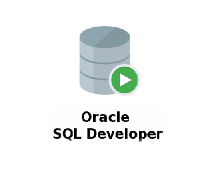
Agenda Problem statement
Data Summary
Exploratory Data Analysis (EDA)
Model Building
Conclusion

Slide 3
PROBLEM STATEMENT In today's competitive job market, recruiters are often flooded with hundreds, even thousands of resumes for a single position. Manually sorting through this volume of data is a time-consuming and error-prone process. This presentation will explore how machine learning can be used to automate resume classification, making the recruitment process faster and more efficient.

Slide 4
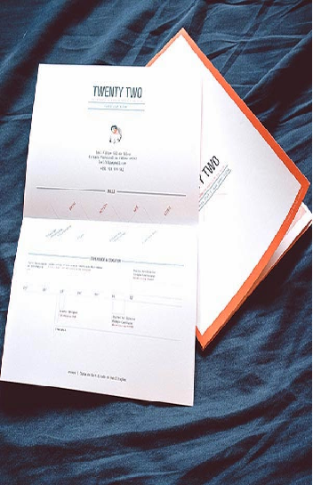
DATA SUMMARY The dataset consists of 4 different categories of resumes: Peoplesoft, React & SQL Developers, and Workday.

Slide 5
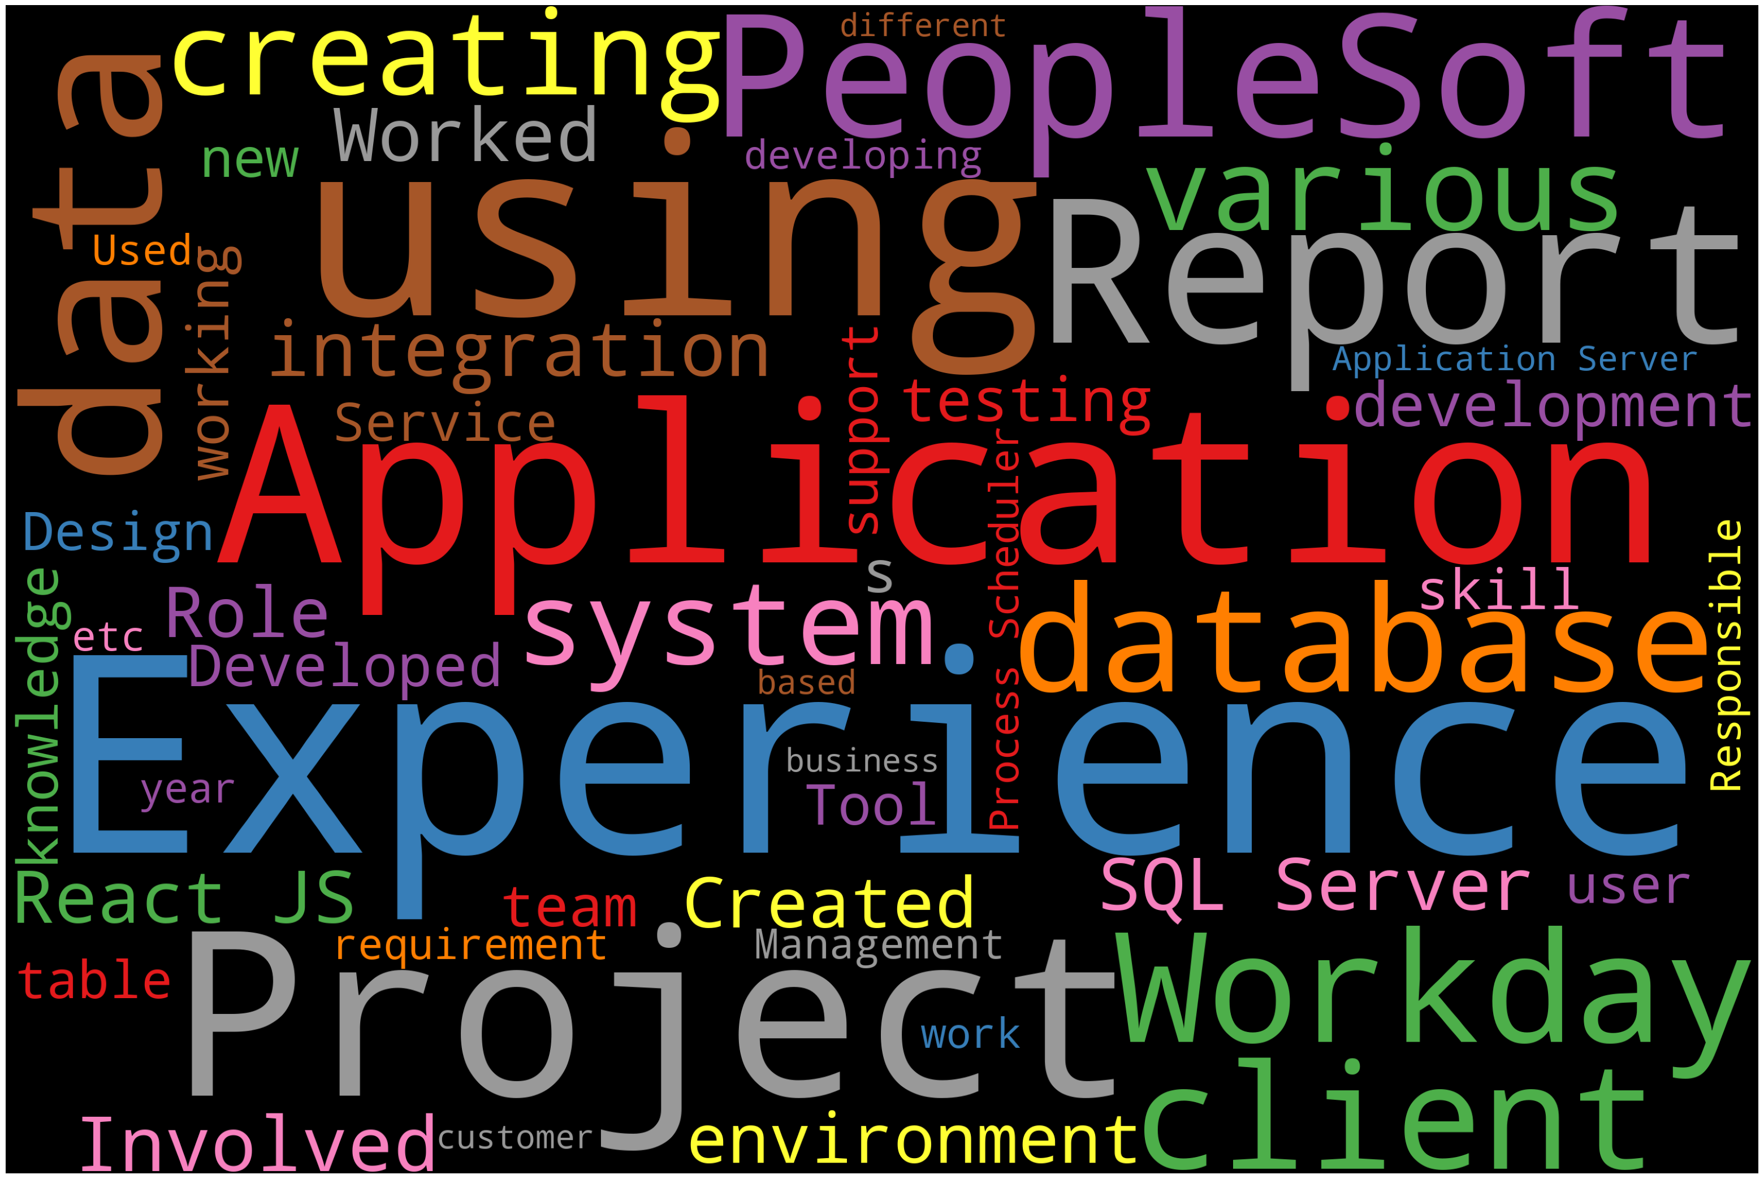
EXPLORATORY DATA ANALYSIS (EDA) Word cloud: Creating a word cloud is a great way to visually represent text data, highlighting the most frequent words by making them larger and more prominent.

Slide 6
The methods we used for Tokenization- Tokenization, in the realm of Natural Language Processing (NLP) and machine learning, refers to the process of converting a sequence of text into smaller parts, known as tokens. These tokens can be as small as characters or as long as words TFIDF vectorizer-Term frequency-inverse document frequency (TF-IDF) is a natural language processing (NLP) technique that's used to measure the importance of different words in a sentence

Slide 7
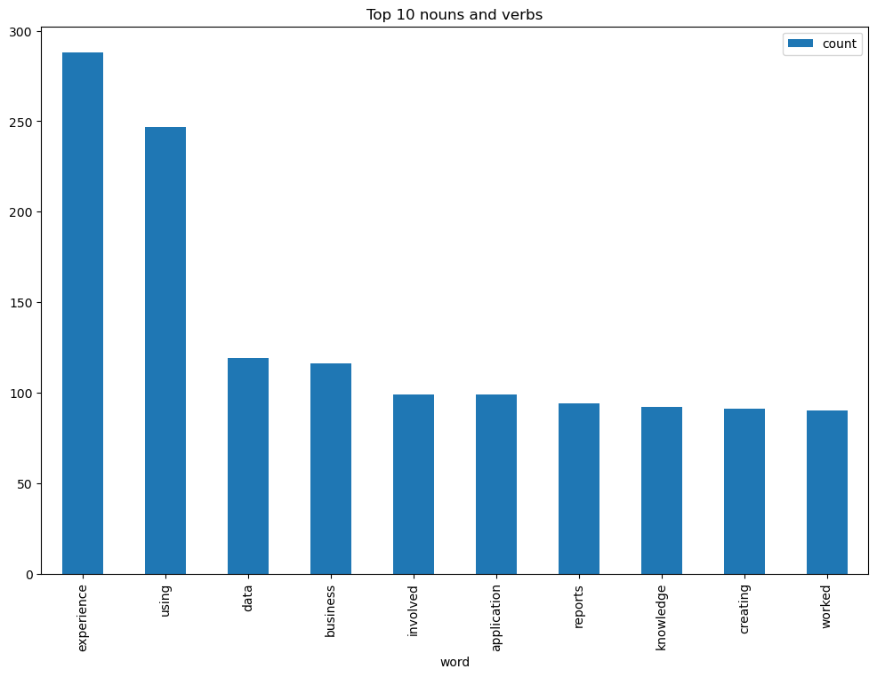
EXPLORATORY DATA ANALYSIS (EDA) Visualizing results Bar chart for top nouns and verbs >Extracting all the skills from each category
>Major skills of Peoplesoft are people soft, oracle, HCM, SQL, java, python.
Skills of React Developer are react, Java script, java, angular, SQL, oracle.
>Skills of SQL Developer are SQL, python, oracle.
>Skills of Workday are workday, HCM, people soft, oracle, SQL, FCM.

Slide 8
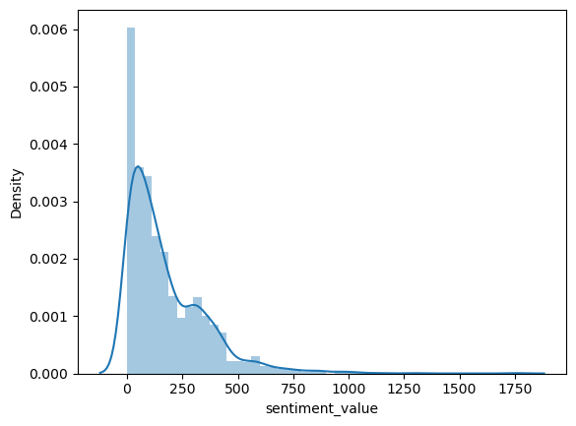
EXPLORATORY DATA ANALYSIS DISTRIBUTION PLOT: A distribution plot, depicts the variation in the data distribution. Seaborn distribution plotrepresents the overall distribution of continuous data variables. The Seaborn module along with the Matplotlib module is used to depict the distribution plot with different variations in it.

Slide 9
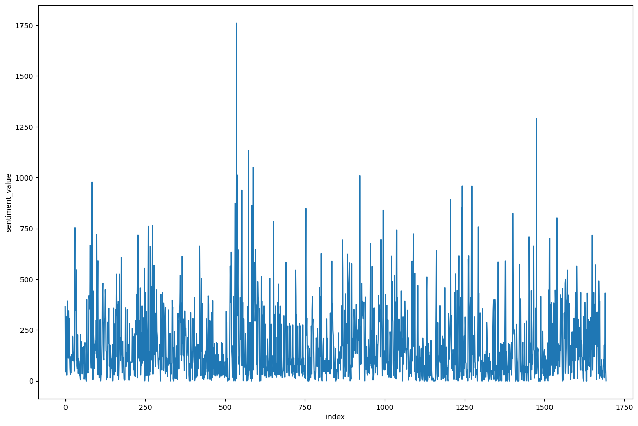
EXPLORATORY DATA ANALYSIS (EDA) LINE PLOT:A line plot, also called a dot plot, is a graph that shows the frequency, or the number of times, a value occurs in a data set. This dot plot contains a random dataset. Line plots are constructed with each value recorded along the horizontal axis, also called the x-axis.

Slide 10
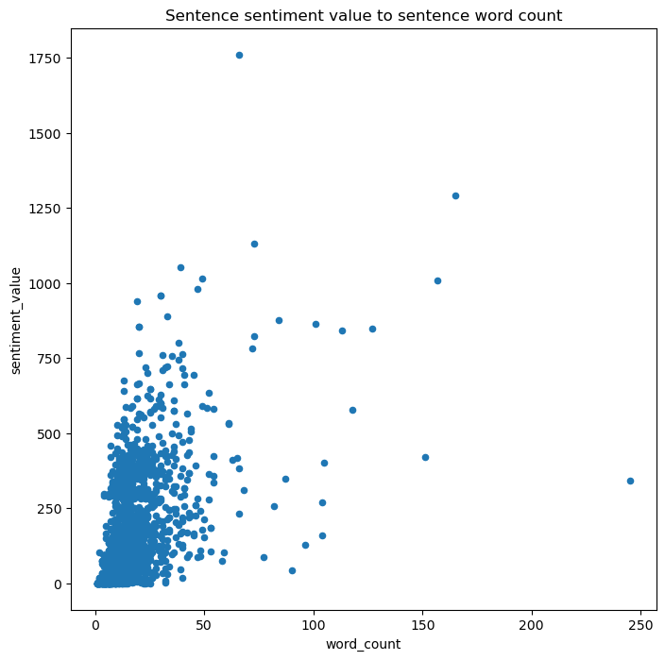
EXPLORATORY DATA ANALYSIS (EDA) Scatter plot : A scatter plot (aka scatter chart, scatter graph) uses dots to represent values for two different numeric variables. The position of each dot on the horizontal and vertical axis indicates values for an individual data point. Scatter plots are used to observe relationships between variables. >Scatter plot has no pattern formed so it is a good sentimental thing.

Slide 11

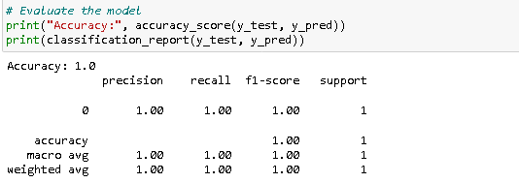
MODEL BUILDING
>In Model building we used few models like Logistic regression, KNN,SVM. > we choose logistic model because the f1 score for logistic regression model is 1 >In logistic regression model we get a accuracy 1.0

Slide 12
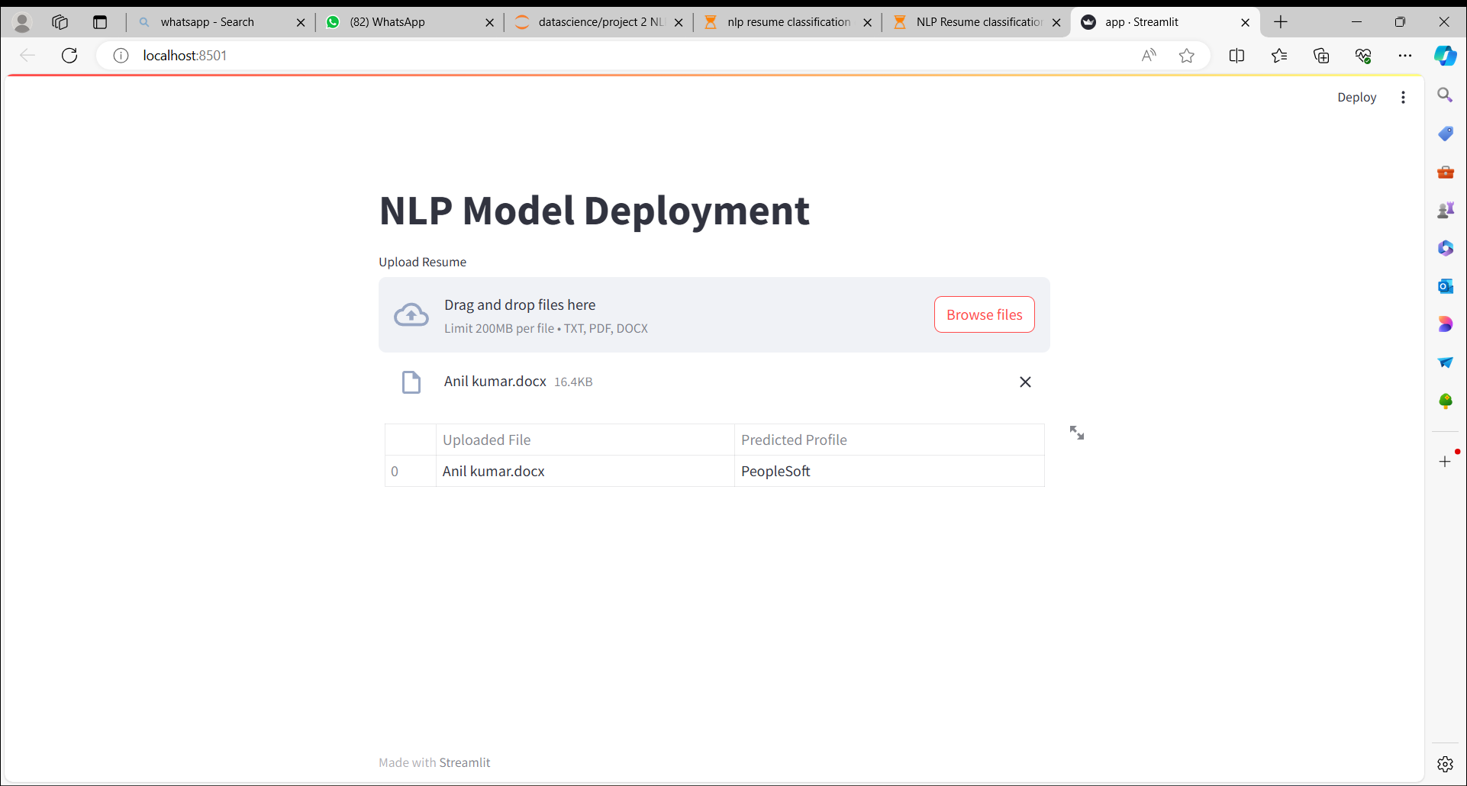
MODEL DEPOLYMENT >Uploads a resume file.
>Preprocesses the text for model compatibility.
>Uses the loaded model to make predictions.
>Displays the predicted job category on the web app.

Slide 13
THANK YOU

